Slide 1
CSK8
It’s Never Too Early to Code
Linda Martin, M.Ed
Technology Integration Specialist
Staten Island Academy

Slide 2
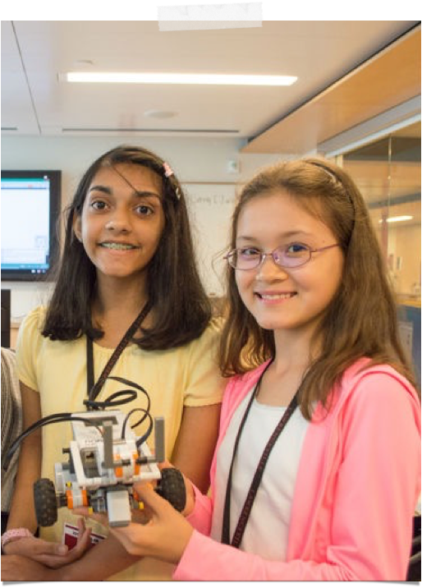
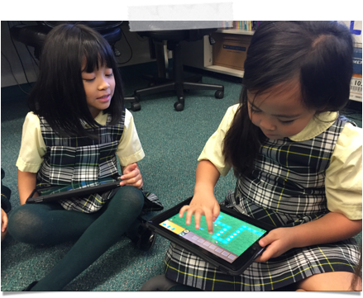
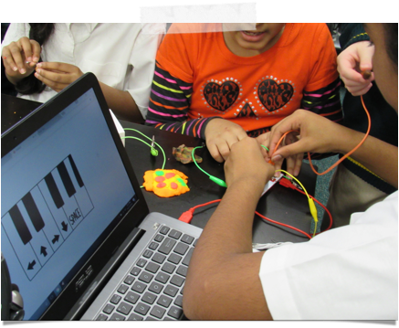
Notes:
For many years the idea of coding wasn’t even considered for middle school let alone early or elementary learners. In a study completed in February of last year, it was determined that students as young as 4 can create and comprehend simple coding concepts. By exposing students at a young age to coding and programming concepts eases their fears about actual programming in their later years.
The educational technology industry has definitely jumped on board with this and there are a multitude of tools available for teachers (and not only technology teachers) to use these to bring excitement to an otherwise simple math or writing assignment.

Slide 3


Benefits of Coding
Algorithms
Comparison /
Decision Making Skills
Problem Solving
Notes:
The definition of algorithm is a process or set of rules to be followed to complete a task. This is what we all do in our every day activities from brushing our teeth to how we travel to work.
Comparing every day tasks or algorithms helps children compare and contrast to determine which would be the more efficient or effective one. The same can be true with computational algorithms.
Coding (or creating an algorithm) can help students break down a big task into smaller steps to help the problem solving process.
Let me share some examples.

Slide 4
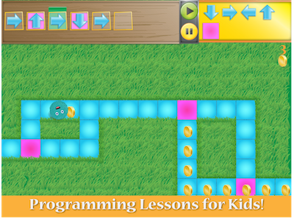
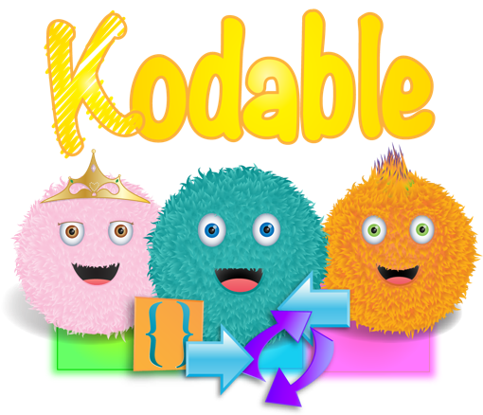

Slide 5
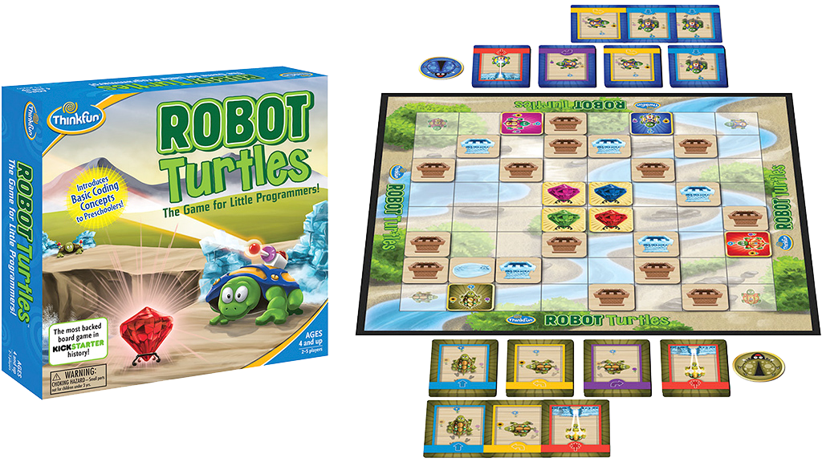
Unplugged Coding
Robot Turtle
Notes:
Other offline activities - give the students arrows and create a “program” to move another student through a maze, or to reach an object.

Slide 6
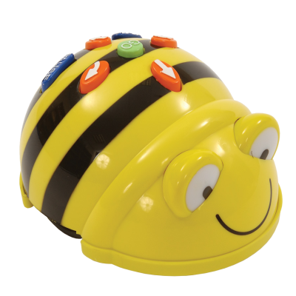
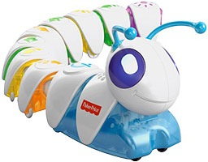
Robotics
BeeBot, Code-a-Pillar
Notes:
Code-a-Pillar was just debuted at CES this year. Child puts sequences together to code the caterpillar to travel.
Both robots encourage students ability to create step by step instructions and understand sequencing.

Slide 7
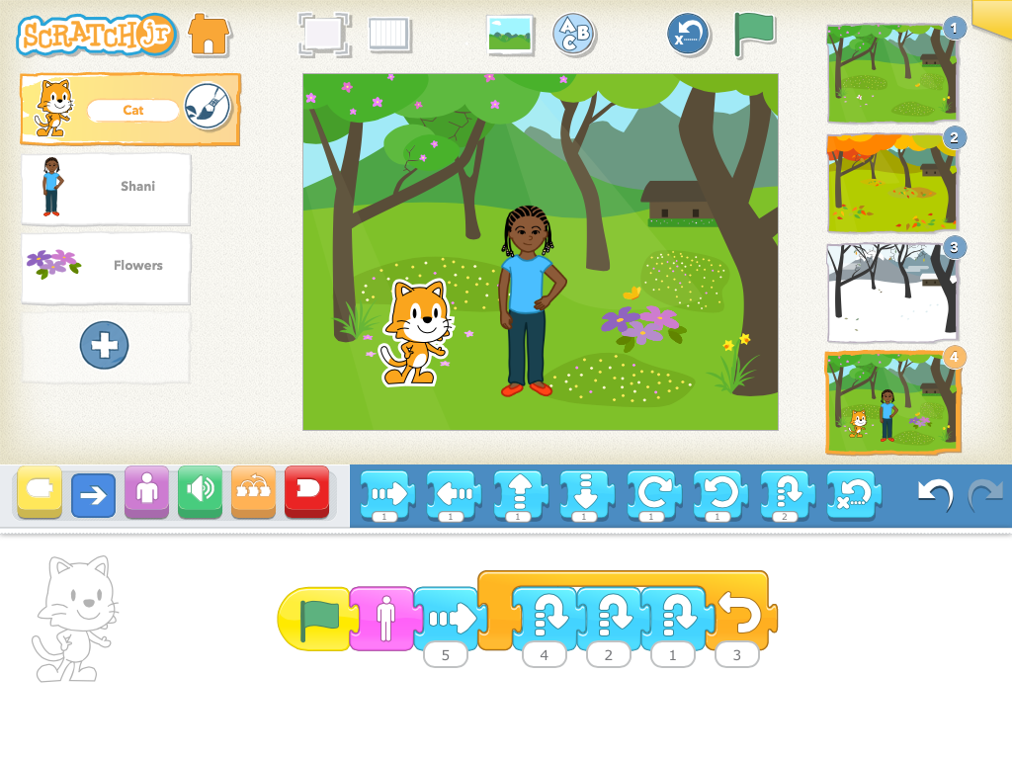
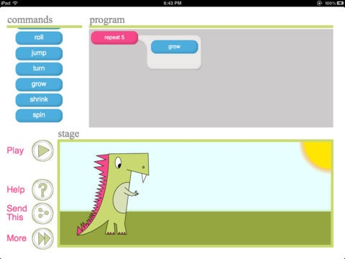
Scratch Jr &
Daisy the Dinosaur
Open-Ended
Animation
Storytelling
Notes:
Students in Grades 1 & 2 find these programs to be “magical” because they can take what seems like a flat object and make it move around the screen. Scratch jr is a good precursor to the Open Source Scratch program created by MIT.
These programs are great for integrating technology into writing and makes their stories come alive. The only negative is the students are limited to the characters and objects that are available in the story.

Slide 8

Code.org
Curriculum available online for early learners through high school and beyond
Notes:
There are several strands of lessons from students and there is a teacher dashboard so that the teacher can see the progress of each student. In between independent work, there are videos (which can be watched individually and in class) and some unplugged activities.
Other sites that offer interactive lessons are:
Tynker - https://www.tynker.com/school/courses/show?id=30-stem-social-studies-131

Slide 9
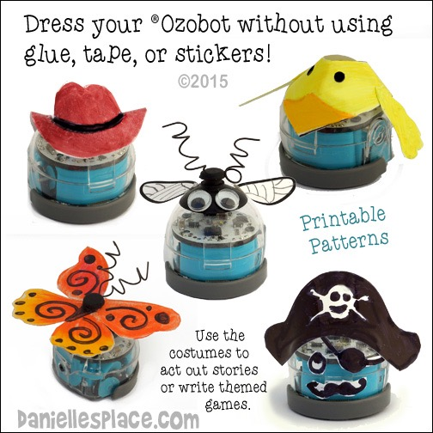
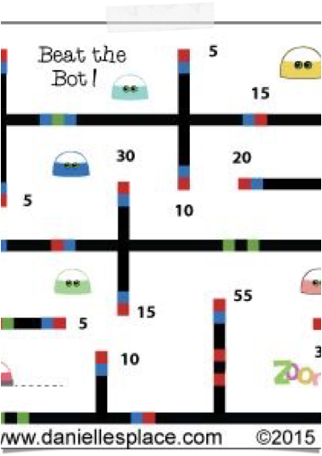
Ozobot
Robot Storytelling
Demonstrate Math Skills
History & Geography
http://portal.ozobot.com/lessons
Notes:
http://games.ozoblockly.com/
https://www.pinterest.com/carolynwarvel/ozobot-crafts-and-learning-activities/
Ozobot Fairytale
Students “act out” a fairytale using Ozobot as the main character.
Ozobot Math
Scale Drawings - Students will take a pre-made maze from Ozobot library and create a large board using scale measurements.
http://ozobot.com/play/print-games
History/Geography
Groups of students will explore plotting timelines, first in a linear context and then in a regional context. The final activity will challenge groups to plot historical events on a gridded geographical map. Then using the map as a reference they will draw a track that will allow Ozobot to visit each historical event in chronological order.

Slide 10
CS Fundamentals Unplugged
https://code.org/curriculum/unplugged

Slide 11
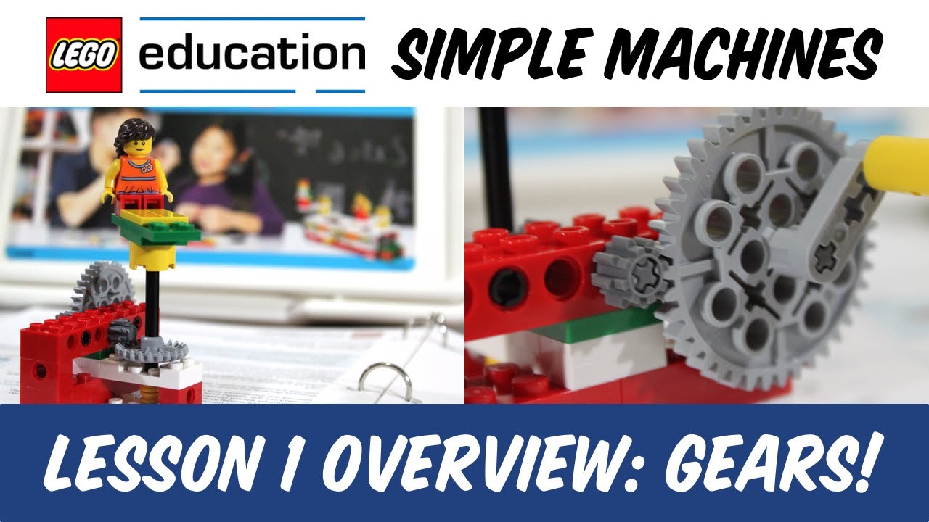
Lego WeDO
Simple Machines
https://scratch.mit.edu/wedo
Notes:
Lego Education has created curriculum and kits to bring to life the ideas learned in science class about simple machines. Problem solving using STEM using Scratch with the we do to create some amazing interactive inventions.

Slide 12
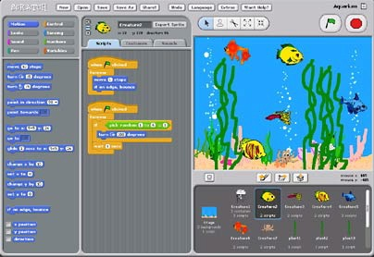
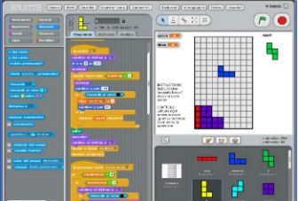
Scratch.MIT.EDU
Basic Animation
Game Design
Video Production

Slide 13
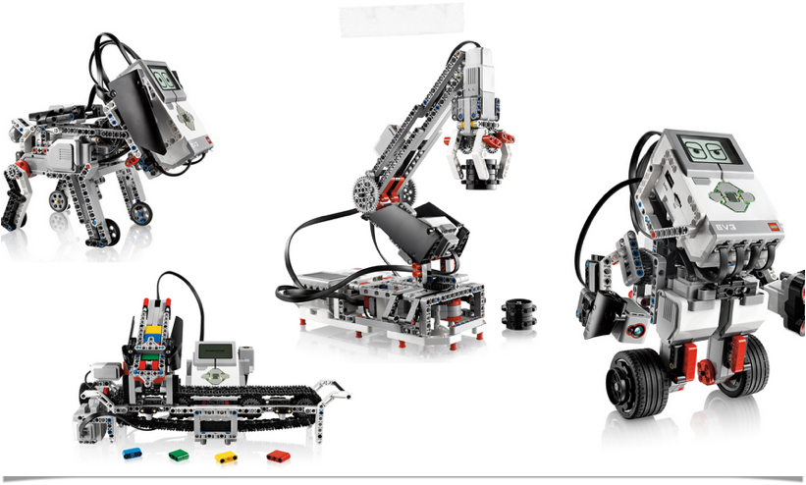
Lego Mindstorm EV3
Choreography, Mazes, Solving Simple Tasks

Slide 14

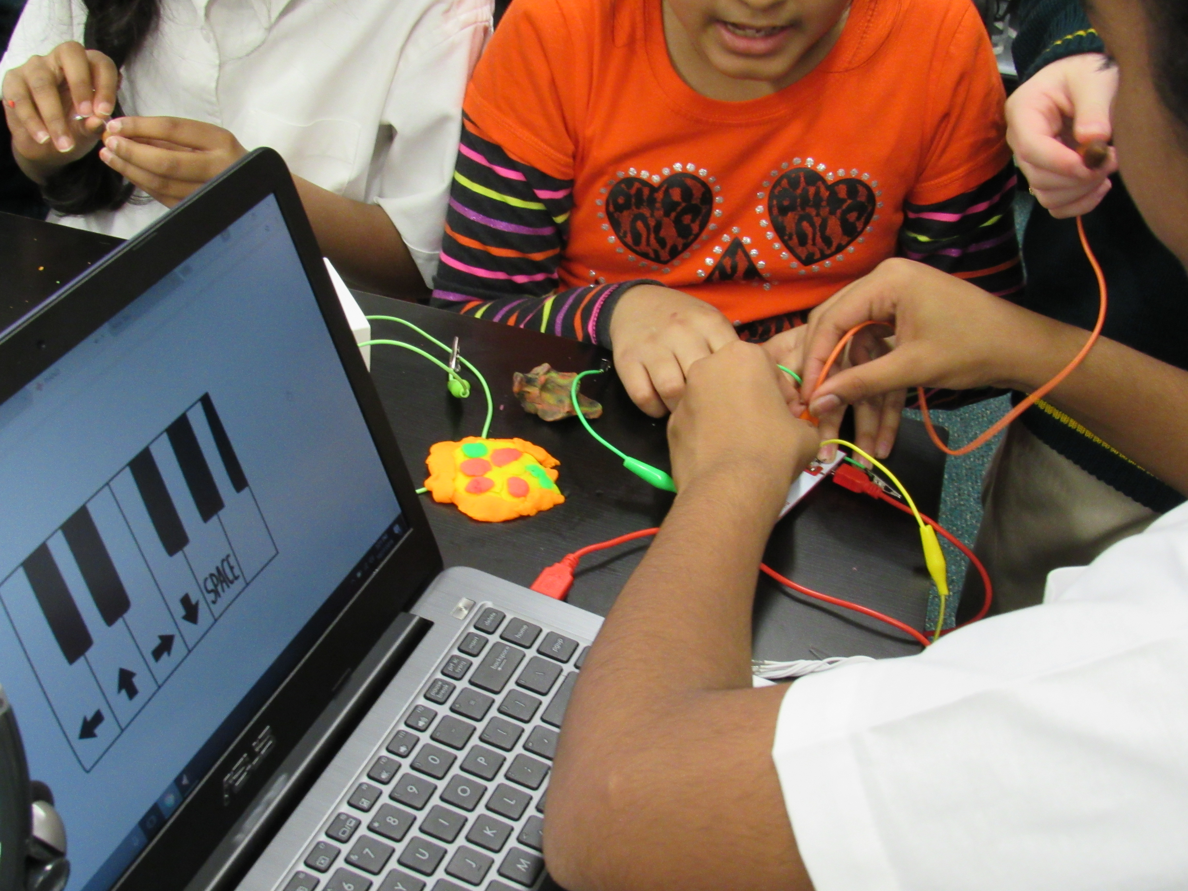
Coding and the Physical World
Arduino
Raspberry Pi
Circuitry
Makey Makey
Notes:
Students can then use what they know to create amazing interactive devices.

Slide 15


FIRST Lego Robotics League
Middle School and Elementary programs

Slide 16
Resources
http://www.mrsmartinusa.com
http://www.CSK8.org
Facebook Group - TinyURL.com/y7z3ests
Twitter - #CSK8

